Slide 1

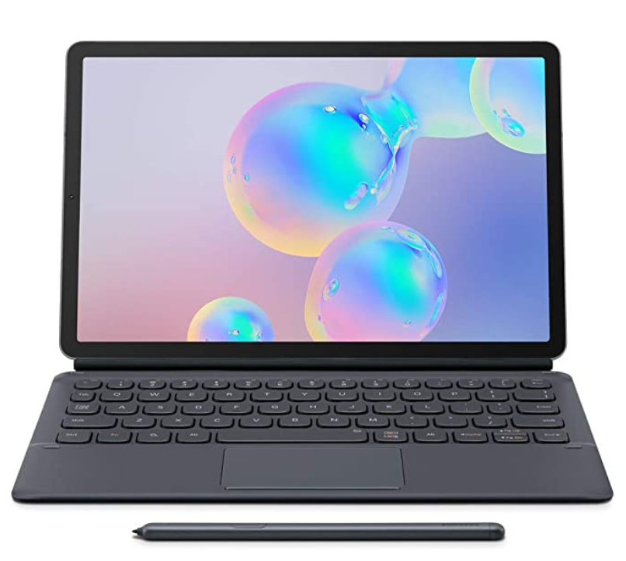

Kaligo
Company name | Kaligo
Contact | Faisal Hamed Director of international development faisal.hamid@learn-and-go.com +44-7538-999-242
Website | www.kaligo-apps.com
Solutions | A dashboard designed to help teachers save time, prepare lesson sequence plans, based on teaching curriculum, individual student progress & requirements, teachers can monitor the progress and reply on each student’s exercises for further analysis. Class management Customized learning model Hand writing solutions ( English/French)
Target Segment | Schools , Kindergartens , Libraries , training centers.
Focus territories | GCC , KSA
References | European Commission , French research laboratories , Hand writing Association Award.
Key Accounts | Académie Nancy-Metz , Pont-à-Mousson school.
GTM | Tab S6 Lite + Kaligo Hand writing solution
Company size | 11-50
Hardware | NO
Company HQ | UK
Local representative | NO – Remotely from Europe
Kaligo handwriting solutions

Slide 2

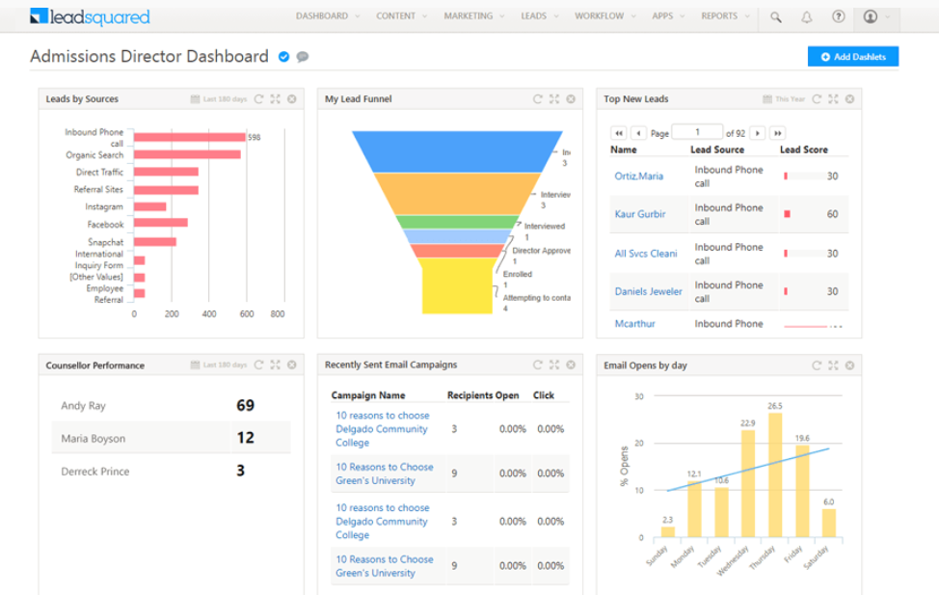
Lead Squared
Company name | Lead Squared
Contact | Prashant Kumar Director of Business Operations prashant.kumar@leadsquared.com +971- 5231-410-69
Website | www.leadsquared.com
Solutions | Solution products and platforms covering (Sales, Field Sales, Marketing and Operations) Sales Execution platform. Field Force automation. Marketing Automation Mobile Call center. Lead engagement. Dynamic content. Field sales tracking.
Target Segment | Schools, Universities, Banks, FMCG
Focus territories | GCC, KSA
Key Accounts | Monash University, Stratford University, Byjus Learning, Bennet University
GTM | Tab /SP + LS solutions
Company size | +100
Hardware | NO
Company HQ | U.S / India
Local representative | Yes
Field Force Automation

Slide 3

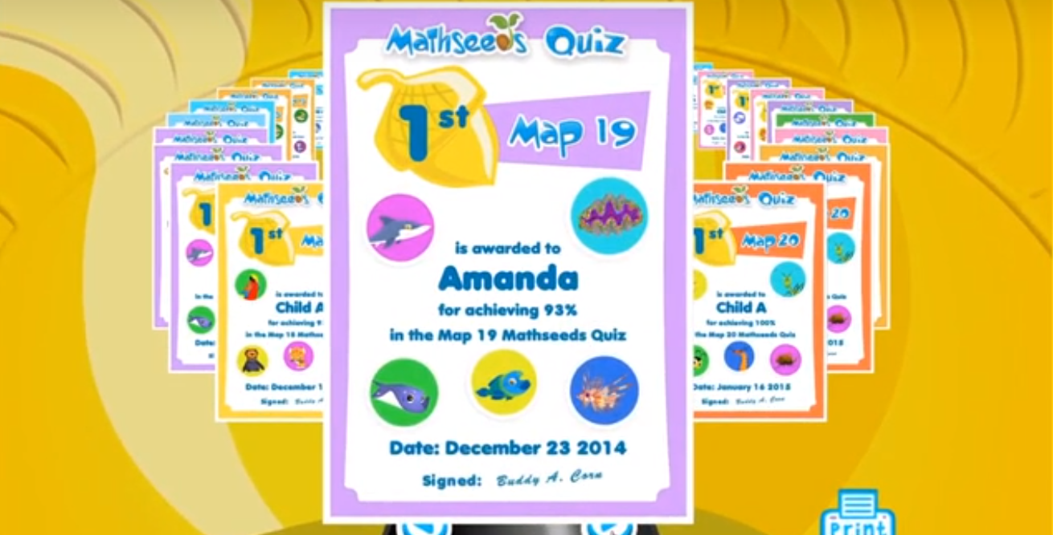
3P Learning
Company name | 3P Learning
Contact | Deane Tomlin Partner Manager – EMEA E: deane.tomlin@3plearning.com +44-7532-040-000
Website | www.3plearning.com
Solutions | Global Online education vendor, designed specifically for schools, covering Mathematics, Spelling and Literacy. Mathletics Readiwriter Reading Eggs Mathseeds Worldflyers STEM Scope science
Target Segment | Schools, Kindergartens, NGO’s
Focus territories | MENA
References | Bett Award 2019 winner, GESS Education Awards, Microsoft Gold Partner 2016, Tech Pioneer winner
GTM | Tab + 3PL solutions
Company size | +100
Hardware | NO
Company HQ | UK
Local representative | Yes
Mathseeds Solution

Slide 4

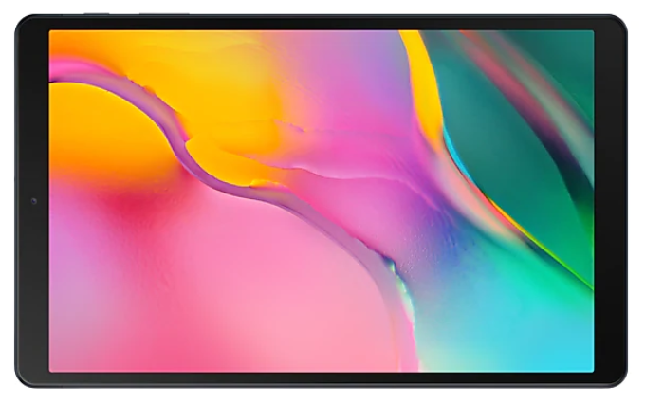
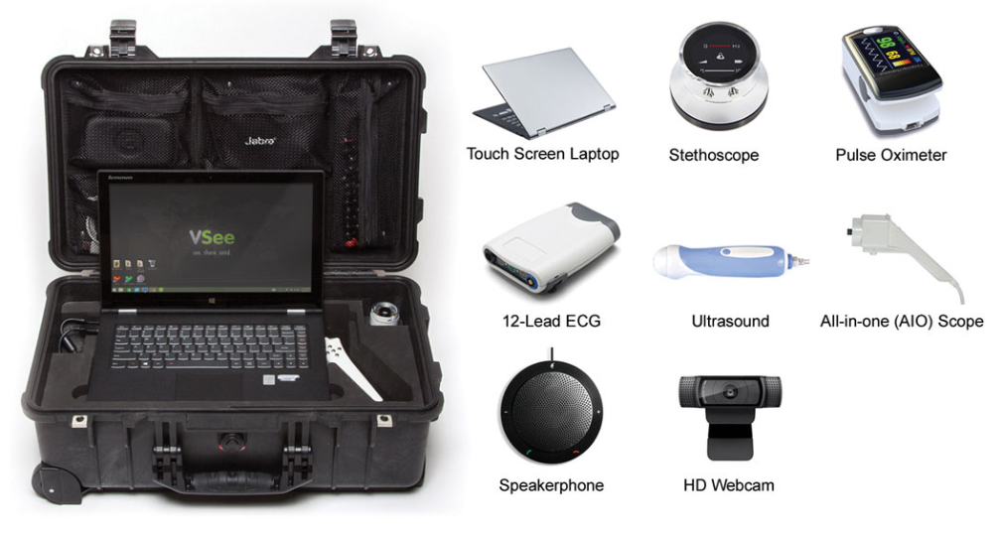
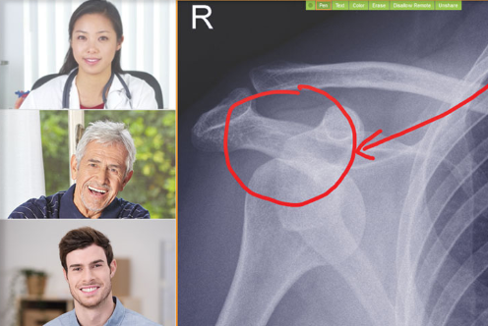
Vsee
Company name | Vsee
Contact | Milton Chen CEO milton@vsee.com +01-6504-001-798
Website | www.vsee.com
Solutions | Global Tele-Medicine Platform serves over 1000 companies including Walgreens, MDLIVE, Trinity, DaVita, HCA, Seton, McKesson-US Oncology, and others Tele-medicine messenger Remote Diagnosis solution Encrypted Video conference calls solution
Target Segment | Hospitals, Medical centers, Medical schools, GOV.
Focus territories | GCC, KSA, North Africa
Key Accounts | Encrypted VC: U.S Congress, NASA Remote Diagnosis: Virtual Diagnosis Nigeria, Philippines, Kurdistan & Chad Tele-Medicine Messenger: USC School of Pharma for Medical Education, NIH
GTM | Tab +Telemedicine kit + Solutions
Company size | 50-100
Hardware | Yes
Company HQ | U.S.A
Local representative | Distributors in GCC Partnership with STC
Telemedicine Kit
Telemedicine Messenger

Slide 5

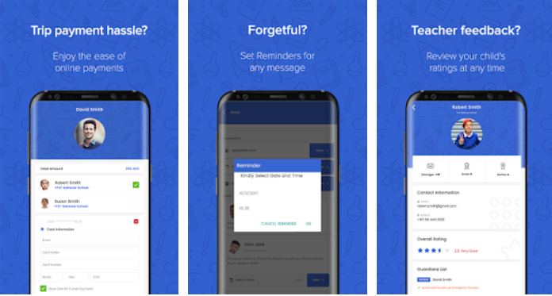
School Voice
Company name | School Voice
Contact | Ali bin Yahia CEO ali.binyahia@schoolvoice.com +971-5099-206-66
Website | www.schoolvoice.com
Solutions | Education platform that eases communication and enhances the engagement between schools, parents, teachers and students LMS School Management Solutions Schools ERP School logistics solutions
Target Segment | Schools, Kindergartens
Focus territories | GCC, KSA, Morocco
Key Accounts | Abu Dhabi educational committee , Chouiefat School , ADNS
GTM | Tab + School voice App
Company size | 11-50
Hardware | Yes
Company HQ | UAE
Local representative | Yes
School Voice App

Slide 6

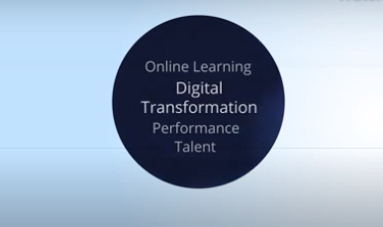
Xpert Learning
Company name | Xpert Learning
Contact | Andrew Robson Consultant andrew@xpertlearning.com +971-5043-286-60
Website | www.xpertlearning.com
Solutions | Online Learning, Talent and Performance Vendor focused on providing Global content and platform solutions for Corporate, Academic and Government sectors in the Middle East region. Online Learning Courses Talent Management Language solutions Education Content
Target Segment | Schools, Kindergartens, Libraries, Training centers, Universities, Corporates
Focus territories | GCC, KSA
References | Emirates NBD, Arabic College, MOE
GTM | Tab + Xpert learning Solutions
Company size | 50-100
Hardware | NO
Company HQ | UAE
Local representative | Yes
Xpert learning solutions

Slide 7

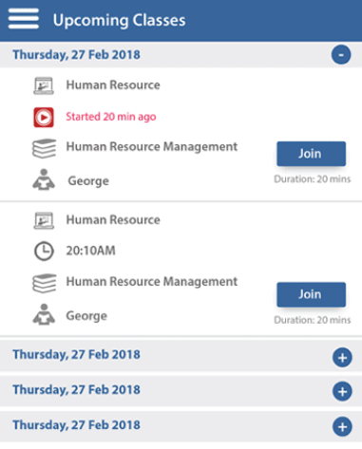
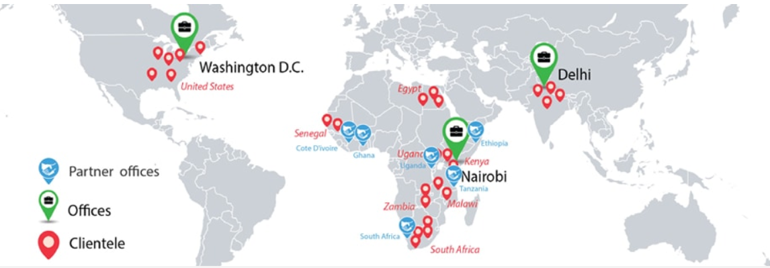
Melimu
Company name | Melimu
Contact | Sumit Paliwal Business Development Manager sumit.paliwal@melimu.com +91-9412-771-890
Website | www.melimu.com
Solutions | Social enterprise focused on mobile-first learning technology K-12 Education Higher Education LMS Solutions Corporate training Content integration
Target Segment | Schools, Libraries, Training centers, Universities, Corporates
Focus territories | MENA
Key Accounts | Pan Africa Christian University, Management University of Africa, SW Open University
GTM | Tab + Melimu Solutions
Company size | +100
Hardware | NO
Company HQ | India
Local representative | No - Remotely
Global presence
LMS solutions

Slide 8

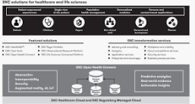
DXC Solutions
Company name | DXC Solutions
Contact | Phil Humber General Manager MENA phil.humber@dxc.com +971-5854-960-94
Website | www.dxc.technology.com
Solutions | DXC’s extensive partner network helps drive collaboration and leverage technology independence Patient tracking solutions Health management solutions
Target Segment | Hospitals, Clinics, Medical centers
Focus territories | MENA
Key Accounts | Ministry of health Brunei , Royal Papworth Hospital , Danish Health Data Authority
GTM | Tab + DXC Solutions
Company size | +100
Hardware | NO
Company HQ | UAE
Local representative | Yes
Health care virtual solution

Slide 9

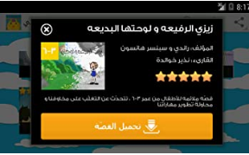
3asafeer (Aasafeer)
Company name | 3asafeer (Aasafeer)
Contact | Amro Abu-Hmaidan CEO amro@3asafeer.com +971-5028-101-51
Website | www.3asafeer.com
Solutions | Content and Arabic learning platform for Pre-school & K12 LMS Solutions Arabic language content Pre-school content Logic & Math Content
Target Segment | Schools, Kindergartens, NGO’s, Libraries, Public schools
Focus territories | MENA
Key Accounts | GEMS Wellington International, GEMS World Academy
GTM | Tab + 3asafeer solution
Company size | 11-50
Hardware | NO
Company HQ | UAE
Local representative | Yes
3asafeer Solution

Slide 10

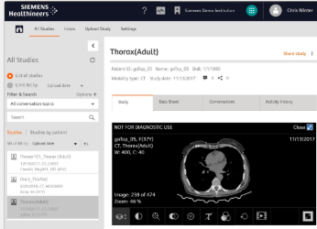
SIEMENS Healthineers
Company name | SIEMENS Healthineers
Contact | Sebastian Andrea Ferrari Stanford Strategy & Business Development Manager sebastian.stanford@siemens-healthineers.com +971-5651-181-69
Website | www.siemens-healthineers.com
Solutions | Global medical technology Vendor Teleconsultation Clinical diagnostic solutions Remote education solutions Smart Simulators
Target Segment | Hospitals, Clinics, Medical centers
Focus territories | MENA
Key Accounts | MOH, Major Hospitals & Clinics across MENA
GTM | Tab + Critical care solution
Company size | +100
Hardware | Yes
Company HQ | Germany
Local representative | Yes
Critical Care & C-19 solutions

